Slide 1



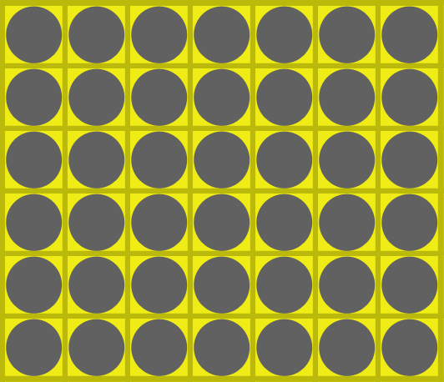
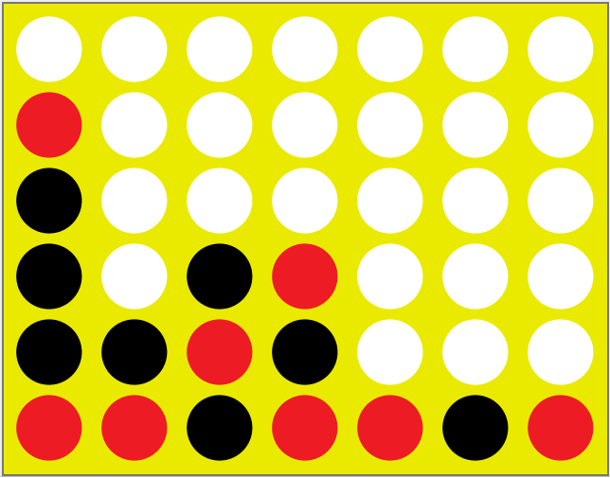
Applied System Software
Mohammed Arham Mohammed 221ADB053
Furqan Ul Islam 211ADB086

Slide 2
Contents of this template
Gaol | To discuss the goal of our task.
PEAS Description | PEAS (Performance measures, Environment, Actuators, and Sensors) of our task.
Rules of the game | Basic rules of the connect 4 game.
Game Complexity | Dsicusing Complexity of the game.
Interface Overview | Discusing interface of the game.
Conlusion | Conclusion along with refences used.

Slide 3
Goal
The goal of this task was to create an agent to play the game Connect Four. The rules for the game were taken from the classic game of Connect Four. However, the environment and the agent program was created from scratch. On the surface the program functions as a simple Connect Four game playable between two human players. In order to make an appropriate agent design, the task environment must first be identified and described.
We have used PEAS (Performance measures, Environment, Actuators, and Sensors) description concept to describe this task environment. The task environment can be further categorized by several other factors, such as observability, number of agents, etc.

Slide 4
PEAS Description
Agent Type | Connect Four Playing Software Agent
1. Performance Measure | Put four pieces adjacent or diagonal to each other, prevent opponent from doing the same.
2. Environment | Game Board, Agent’s pieces, and Opponent’s pieces.
3. Acutators | Piece placing function.
4. Sensors | Direct access of the state board

Slide 5

Rules of the game
Connect-Four is a game for two persons. Both players have 21 identical pieces. In the standard form of the game, one set of pieces is red and the other set is yellow. The game is played on a vertical, rectangular board consisting of 7 vertical columns of 6 squares each. If one piece is put in one of the columns, it will fall down to the lowest unoccupied square in the column. As soon as a column contains 6 pieces, no other piece can be put in the column. Putting a piece in one of the columns is called a move.

Slide 6

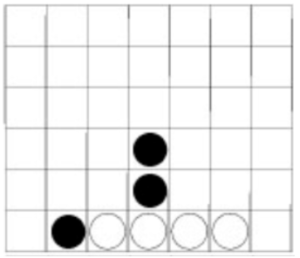
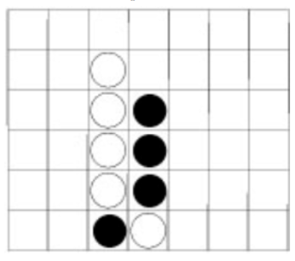
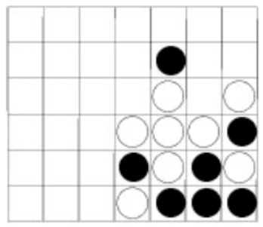
Rules of the game
The players make their moves in turn. There are no rules stating that the player with, for instance, the red pieces should start. Since it is confusing to identify for each new game the color that started the game, we will assume that the sets of pieces are colored white and black instead of red and yellow. Like chess and checkers (and unlike go) it is assumed that the player playing the white pieces will make the first move.
Figure 1
Figure 2
Figure 2

Slide 7
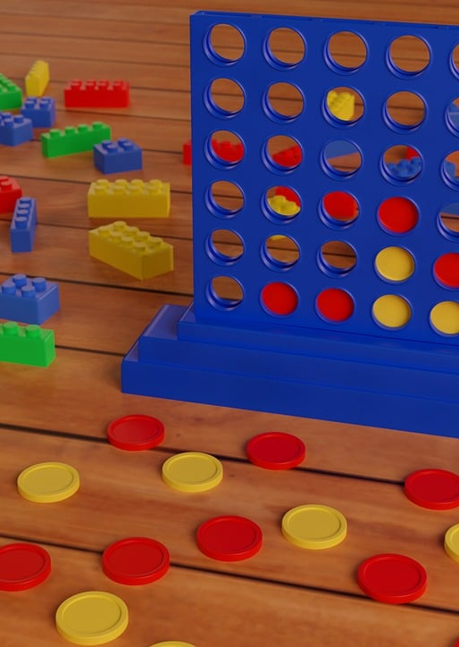
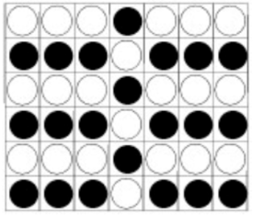
Rules of the game
Both Players will try to get four connected pieces, horizontally, vertically or diagonally. The first player who achieves one such group of four connected pieces wins the game. If all 42 pieces are played and no player has achieved this goal, the game is a draw.
A possible drawn position:

Slide 8
Game Complexity
Legal vs. Illegal Positions: Legal positions are those that can occur during a game following the rules, while illegal positions cannot.
State of Each Square: On a Connect-Four board, each of the 42 squares can be empty, occupied by a white piece, or occupied by a black piece.
Total Possible Positions: Considering all possible configurations, the number of potential positions is at most 3⁴², which is approximately 10²⁰.
Reduction of Upper Bound: By incorporating the rules of Connect-Four, such as player turns and win conditions, the upper bound on the 7x6 board reduces to 7.1×10¹³.
Initial Upper Bound: This initial estimate is very crude and includes many illegal positions, providing a starting point for more accurate calculations.

Slide 9
Interface Overview
Two-Part Interface:
Menu: Provides access to various game controls, settings, and player management options.
Game Board: The visual representation of the Connect-Four board where the game is played.
Menu Functions:
Game Controls: Start new games, restart current games, or quit the game.
AI Algorithm Selection: Choose which AI algorithm will control the AI players.
Player Configuration: Designate each player as either a human or an AI agent.
Switching Players:
Dynamic Switching: Allows users to switch between human and AI players at any point during the game.
Testing Scenarios: Useful for observing how AI responds to different board configurations set up by human players.
Initial Configuration:
Starting Position: The game begins with an empty board with 42 empty squares.
Turn-Based Play: Players take alternating turns to drop pieces into one of the seven columns.
User Interaction:
Move Execution: Human players make their moves by clicking the button above the desired column, which then drops a piece into the column.
Real-Life Simulation: This button-based interaction mirrors the real-life gameplay of Connect-Four, where pieces are dropped from the top of the board.

Slide 10
Conclusion
The most experience was gained in computer game-playing agent design.
The ideal algorithm for success may be beyond current technological capabilities.
Alternative algorithms can still create an engaging playing experience.
A crucial game design concept is that players prefer games where they have a chance to win.
A perfect algorithm that always wins could reduce human interest in the game.
The main task of the project was to create comprehensive documentation.
The documentation included requirements, software design, and testing documents.
These formal documents were essential for a structured and thorough development process.
The documentation facilitated effective communication and project management.

Slide 11
Thank You
References:
https://0xadada.pub/2003/12/15/connect-four-playing-ai-agent/
https://github.com/0xadada/smart-connect-four

